Slide 1
Automotive Systems – Perception and situation understanding Simulative Robot Detection with different sensors and Kalman-filter
Prof. Dr.-Ing. Raoul Zöllner
Johannes Buyer, M. Eng.
lgerstla@stud.hs-heilbronn.de, jkurz1@stud.hs-heilbronn.de

Slide 2
Problem description
Observation of Robots in a room
Two Cameras with limited Field of View
One LiDAR with low angular resolution
Only position measurable
Known state equation of robots

Slide 3
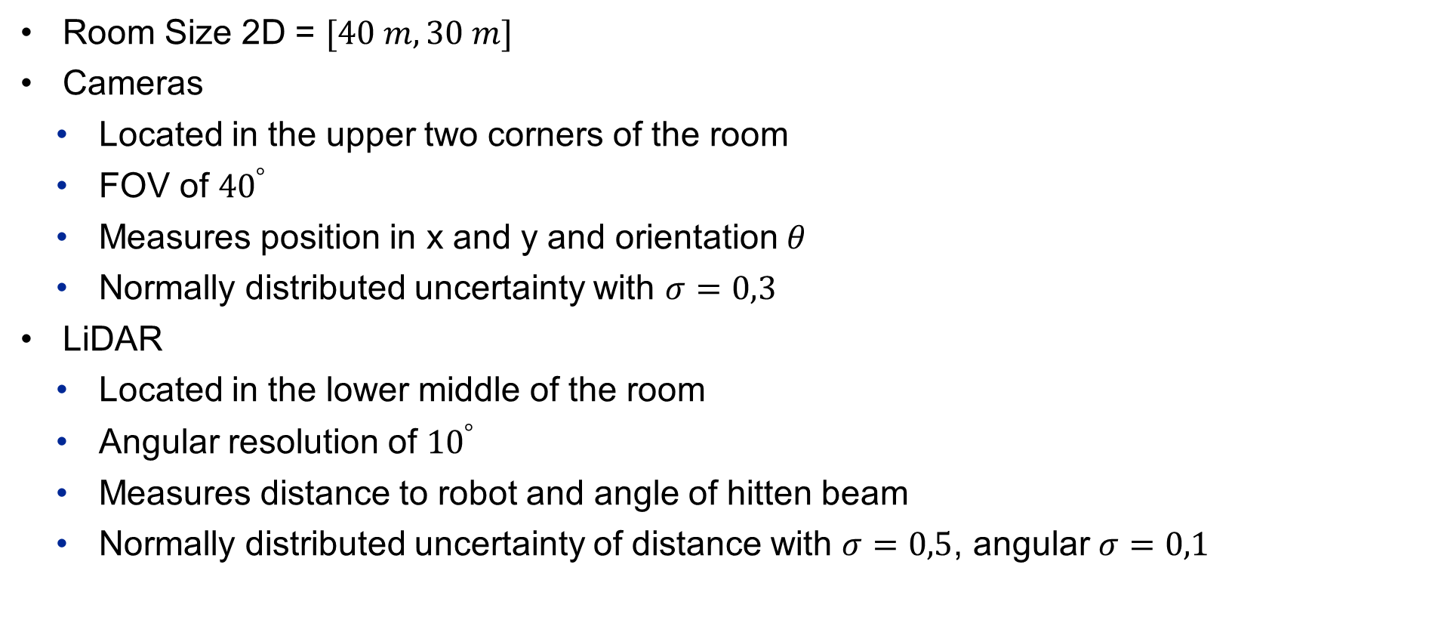
Boundary conditions
Room Size 2D = $[40 m, 30 m]$
Cameras
Located in the upper two corners of the room
FOV of ${40}^{°}$
Measures position in x and y and orientation $θ$
Normally distributed uncertainty with $σ=0,3$
LiDAR
Located in the lower middle of the room
Angular resolution of ${10}^{°}$
Measures distance to robot and angle of hitten beam
Normally distributed uncertainty of distance with $σ=0,5$, angular $σ=0,1$

Slide 4
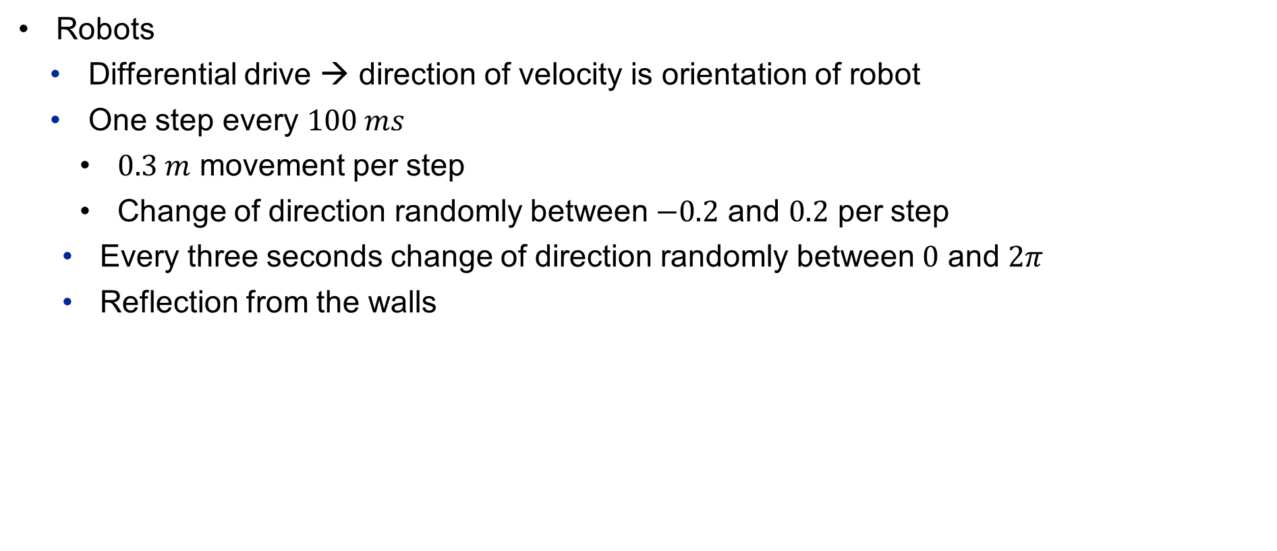
Boundary conditions
Robots
Differential drive → direction of velocity is orientation of robot
One step every $100 ms$
$0.3 m$ movement per step
Change of direction randomly between $−0.2$ and $0.2$ per step
Every three seconds change of direction randomly between $0$ and $2π$
Reflection from the walls

Slide 5
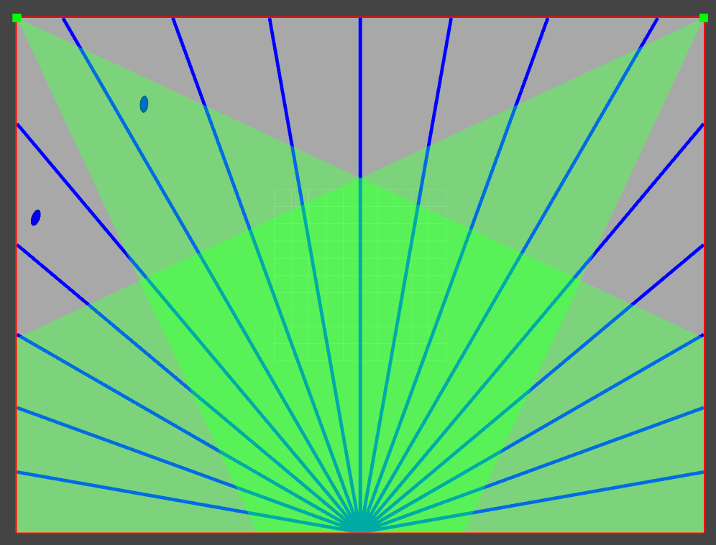
Visualization of room, Sensors and robots

Slide 6
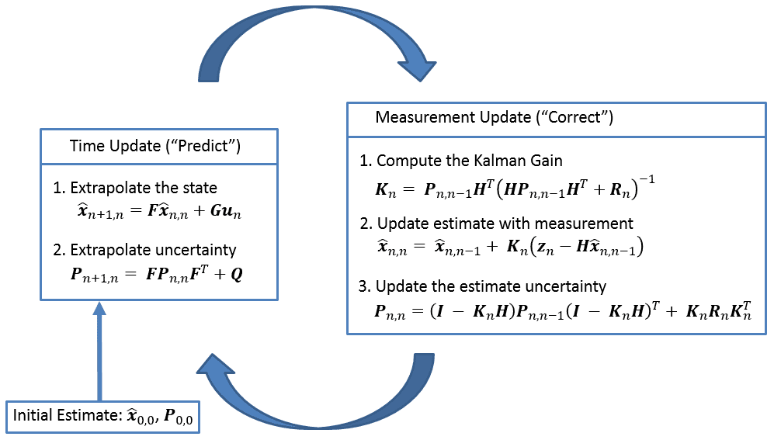
Chosen solution approach
Multi Target Tracking with Mahalanobis distance-based data association
Extended Kalman-Filer
https://www.kalmanfilter.net/img/summary/KalmanFilterDiagram.png

Slide 7
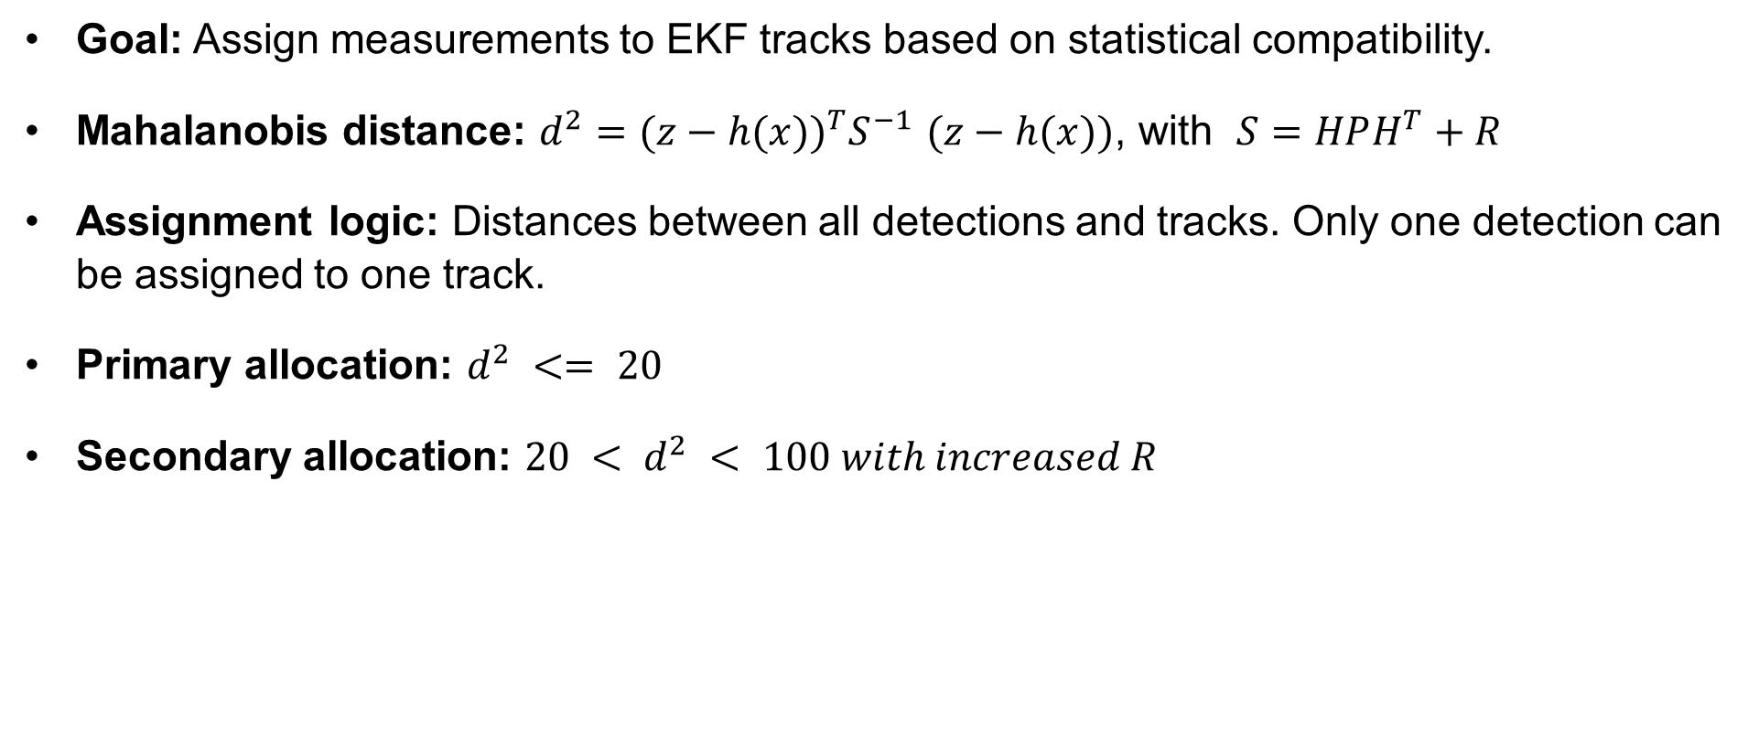
Mahalanobis Distance & Multi-Target Data Association
Goal: Assign measurements to EKF tracks based on statistical compatibility.
Mahalanobis distance: $d^{2}={(z−h(x))}^{T}S^{−1}$ $(z−h(x))$, with $S=HPH^{T}+R$
Assignment logic: Distances between all detections and tracks. Only one detection can be assigned to one track.
Primary allocation: $d^{2} <= 20$
Secondary allocation: $20 < d^{2} < 100 with increased R$

Slide 8
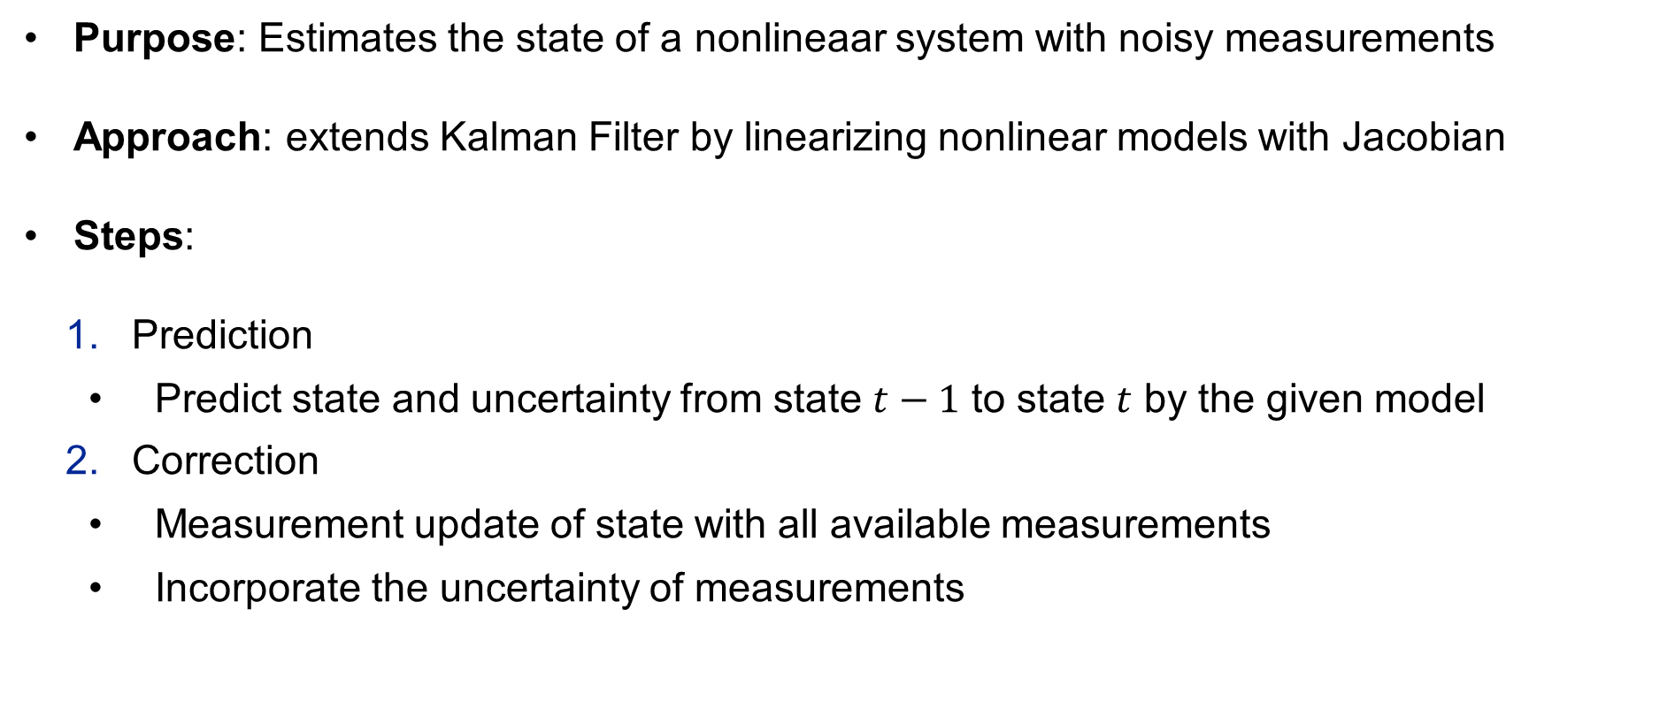
Extended Kalman filter
Purpose: Estimates the state of a nonlineaar system with noisy measurements
Approach: extends Kalman Filter by linearizing nonlinear models with Jacobian
Steps:
Prediction
Predict state and uncertainty from state $t−1$ to state $t$ by the given model
Correction
Measurement update of state with all available measurements
Incorporate the uncertainty of measurements

Slide 9

State vector, measurement vector
State vector: $x=\left[\begin{matrix}x \\ y \\ \begin{aligned}θ \\ v \\ ω\end{aligned}\end{matrix}\right]$
Input vector: $u=[ ]$
Measurement vector: $z_{camera}=\left[\begin{matrix}x \\ \begin{aligned}y \\ θ\end{aligned}\end{matrix}\right]$
$z_{lidar}=\left[\begin{matrix}x \\ y\end{matrix}\right]$

Slide 10

Motion / Transition Model
$x_{k}=x_{k−1}+v_{k−1}⋅\cos\left(θ_{k−1}\right)⋅dt$
$y_{k}=y_{k−1}+v_{k−1}⋅\sin\left(θ_{k−1}\right)⋅dt$
$θ_{k}=θ_{k−1}+ω_{k}⋅dt$
$v_{k}=\frac{\sqrt{{\left(x_{k}−x_{k−1}\right)}^{2}+{(y−y_{k−1})}^{2}}}{dt}$
$ω_{k}=\frac{θ_{k}−θ_{k−1}}{dt}$
System dynamics function$: f\left(x\right)=\left[\begin{matrix}x+v⋅\cos\left(θ_{k}\right)⋅dt \\ y+v⋅\sin\left(θ_{k}\right)⋅dt \\ θ+ω⋅dt \\ v \\ ω\end{matrix}\right]$

Slide 11

Measurement Model
Measurement function: $h_{camera}\left(x\right)=\left[\begin{matrix}x \\ \begin{aligned}y \\ θ\end{aligned}\end{matrix}\right]$
$h_{lidar}(x)=\left[\begin{matrix}x \\ y\end{matrix}\right]$

Slide 12
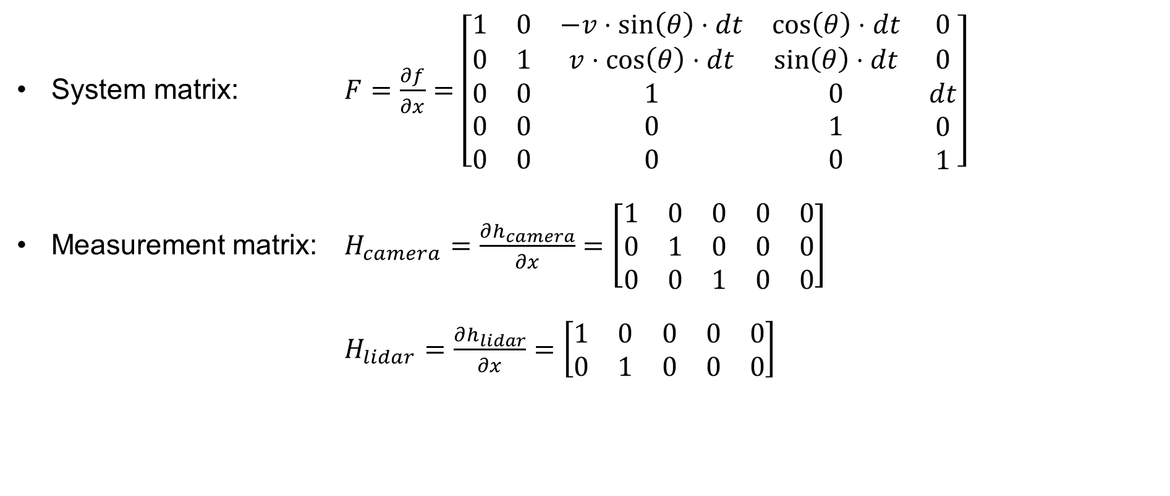
Jacobi-matrices
System matrix: $F=\frac{∂f}{∂x}=\left[\begin{matrix}1 & 0 & −v⋅\sin\left(θ\right)⋅dt & \cos\left(θ\right)⋅dt & 0 \\ 0 & 1 & v⋅\cos\left(θ\right)⋅dt & \sin\left(θ\right)⋅dt & 0 \\ \begin{aligned}0 \\ 0 \\ 0\end{aligned} & \begin{aligned}0 \\ 0 \\ 0\end{aligned} & \begin{aligned}1 \\ 0 \\ 0\end{aligned} & \begin{aligned}0 \\ 1 \\ 0\end{aligned} & \begin{aligned}dt \\ 0 \\ 1\end{aligned}\end{matrix}\right]$
Measurement matrix: $H_{camera}=\frac{∂h_{camera}}{∂x}=\left[\begin{matrix}1 & 0 & 0 & 0 & 0 \\ 0 & 1 & 0 & 0 & 0 \\ 0 & 0 & 1 & 0 & 0\end{matrix}\right]$
$H_{lidar}=\frac{∂h_{lidar}}{∂x}=\left[\begin{matrix}1 & 0 & 0 & 0 & 0 \\ 0 & 1 & 0 & 0 & 0\end{matrix}\right]$

Slide 13
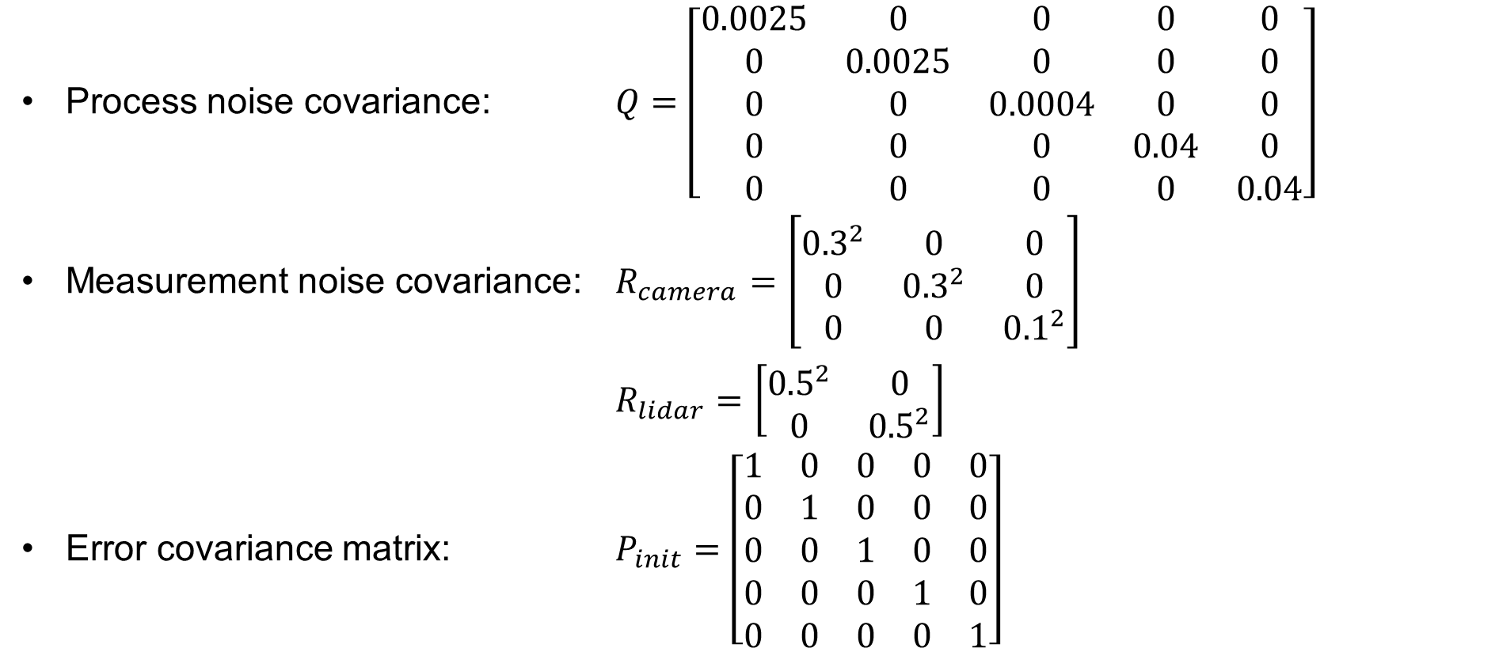
Parameterization of the filter
Process noise covariance: $Q=\left[\begin{matrix}0.0025 & 0 & 0 & 0 & 0 \\ 0 & 0.0025 & 0 & 0 & 0 \\ 0 & 0 & 0.0004 & 0 & 0 \\ 0 & 0 & 0 & 0.04 & 0 \\ 0 & 0 & 0 & 0 & 0.04\end{matrix}\right]$
Measurement noise covariance: $R_{camera}=\left[\begin{matrix}{0.3}^{2} & 0 & 0 \\ 0 & {0.3}^{2} & 0 \\ 0 & 0 & {0.1}^{2}\end{matrix}\right]$
$R_{lidar}=\left[\begin{matrix}{0.5}^{2} & 0 \\ 0 & {0.5}^{2}\end{matrix}\right]$
Error covariance matrix: $P_{init}=$ $\left[\begin{matrix}1 & 0 & 0 & 0 & 0 \\ 0 & 1 & 0 & 0 & 0 \\ 0 & 0 & 1 & 0 & 0 \\ 0 & 0 & 0 & 1 & 0 \\ 0 & 0 & 0 & 0 & 1\end{matrix}\right]$

Slide 14
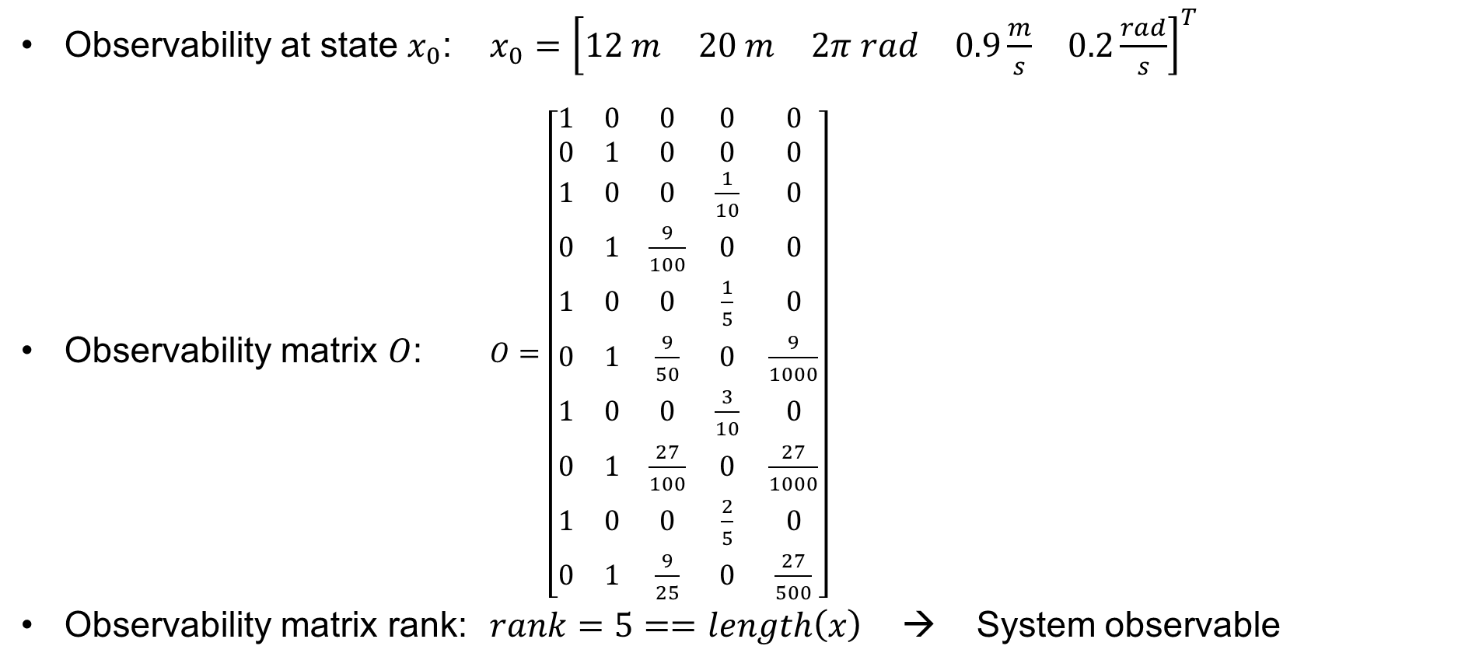
observability
Observability at state $x_{0}$: $x_{0}={\left[\begin{matrix}12 m & 20 m & 2π rad & 0.9\frac{m}{s} & 0.2\frac{rad}{s}\end{matrix}\right]}^{T}$
Observability matrix $O$: $O=\left[\begin{matrix}1 & 0 & 0 & 0 & 0 \\ 0 & 1 & 0 & 0 & 0 \\ 1 & 0 & 0 & \frac{1}{10} & 0 \\ 0 & 1 & \frac{9}{100} & 0 & 0 \\ 1 & 0 & 0 & \frac{1}{5} & 0 \\ 0 & 1 & \frac{9}{50} & 0 & \frac{9}{1000} \\ 1 & 0 & 0 & \frac{3}{10} & 0 \\ 0 & 1 & \frac{27}{100} & 0 & \frac{27}{1000} \\ 1 & 0 & 0 & \frac{2}{5} & 0 \\ 0 & 1 & \frac{9}{25} & 0 & \frac{27}{500}\end{matrix}\right]$
Observability matrix rank: $rank=5==length\left(x\right)$ → System observable

Slide 15
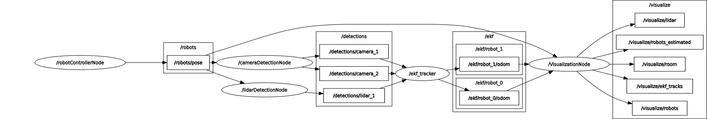
Structure of the implemented program
Implementation in ROS2 Nodes
robotControllerNode → Simulation of roboter movement
*DetectionNode → Simulation of detection with added noise
ekfNode → extended Kalman-Filter
visualizationNode → Visualization of room, roboters, sensors, covariance

Slide 16
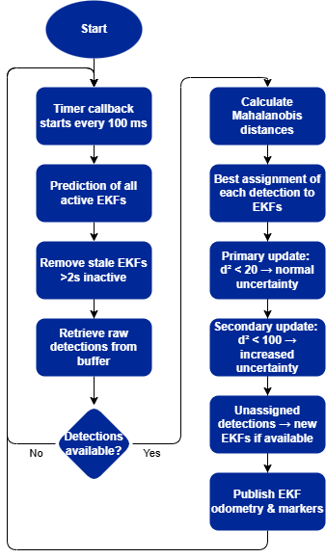
Flowchart

Slide 17
System Limitations
Currently limited to two robots (assumption for Kalman filter)
Rejection of measurements above threshold
Uncertainty when robots are close to each other
Deletion of the Kalman filter if no assignable measurement was received for two second → Robots are no longer detected after two second if they are not measured
Second EKF on the same robot, if only this one has been measured in the last 2 seconds, when detection over threshold 100

Slide 18
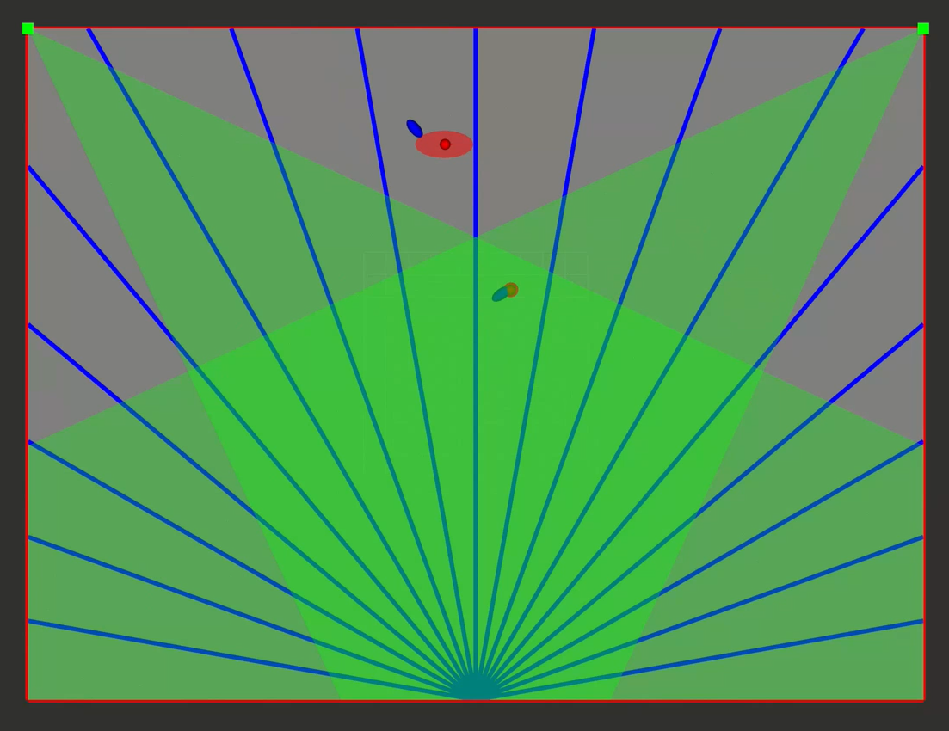
results
[Prediction] State 0: Predicted Position: (-16.95, 8.61)
[Prediction] State 1: Predicted Position: (-16.13, -10.44)
[Stale Removal] Removing EKF 0 after 2s timeout.
[Detection] 2 detections received.
[Detection Info] Detection 0: Sensor=camera_1, Position= (-16.15, -11.96)
[Detection Info] Detection 1: Sensor=camera_2, Position= (-17.00, 8.36)
[Mahalanobis] Detection 0 to State 1: d² = 16.88
[Mahalanobis] Detection 1 to State 1: d² = 2577.87
[Update] Detection 0 assigned to State 1 (Primary Threshold, d²=16.88). Updated Position: (-16.14, -10.64)
[No Update] Detection 1 could not be assigned.
Initialized EKF for Robot 0 at (-17.00, 8.36)
[Init] New EKF State 0 from Detection -17.00, 8.36

Slide 19
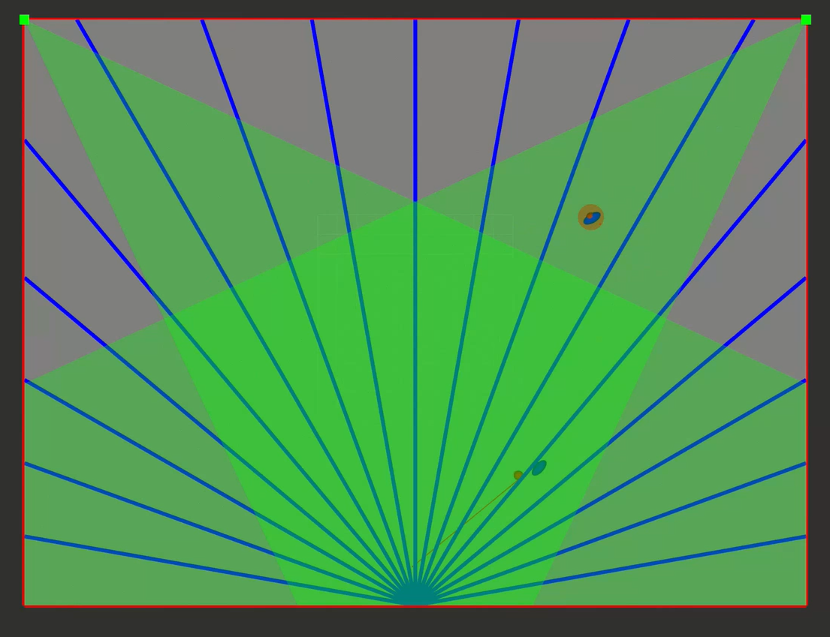
Results
[Prediction] State 0: Predicted Position: (-12.96, 8.51)
[Prediction] State 1: Predicted Position: (-7.63, -5.99)
[Detection] 5 detections received.
[Detection Info] Detection 0: Sensor=lidar, Position=(-15.02, 7.79)
[Detection Info] Detection 1: Sensor=lidar, Position=(-7.55, -7.82)
[Detection Info] Detection 2: Sensor=camera_1, Position=(-7.65, -6.57)
[Detection Info] Detection 3: Sensor=camera_2, Position=(-12.67, 8.75)
[Detection Info] Detection 4: Sensor=camera_2, Position=(-7.29, -7.35)
[Mahalanobis] Detection 0 to State 0: d² = 52.37
[Mahalanobis] Detection 0 to State 1: d² = 2438.62
[Mahalanobis] Detection 1 to State 0: d² = 1970.24
[Mahalanobis] Detection 1 to State 1: d² = 41.30
[Mahalanobis] Detection 2 to State 0: d² = 1215.47
[Mahalanobis] Detection 2 to State 1: d² = 2.38
[Mahalanobis] Detection 3 to State 0: d² = 0.88
[Mahalanobis] Detection 3 to State 1: d² = 1577.47
[Mahalanobis] Detection 4 to State 0: d² = 1349.87
[Mahalanobis] Detection 4 to State 1: d² = 13.19
[Update] Detection 0 assigned to State 0 (Secondary Threshold, d²=52.37). Updated Position: (-13.41, 8.34)
[Update] Detection 1 assigned to State 1 (Secondary Threshold, d²=41.30). Updated Position: (-7.53, -6.34)
[Update] Detection 2 assigned to State 1 (Primary Threshold, d²=2.38). Updated Position: (-7.56, -6.36)
[Update] Detection 3 assigned to State 0 (Primary Threshold, d²=0.88). Updated Position: (-13.31, 8.41)
[Update] Detection 4 assigned to State 1 (Primary Threshold, d²=13.19). Updated Position: (-7.49, -6.47)

Slide 20
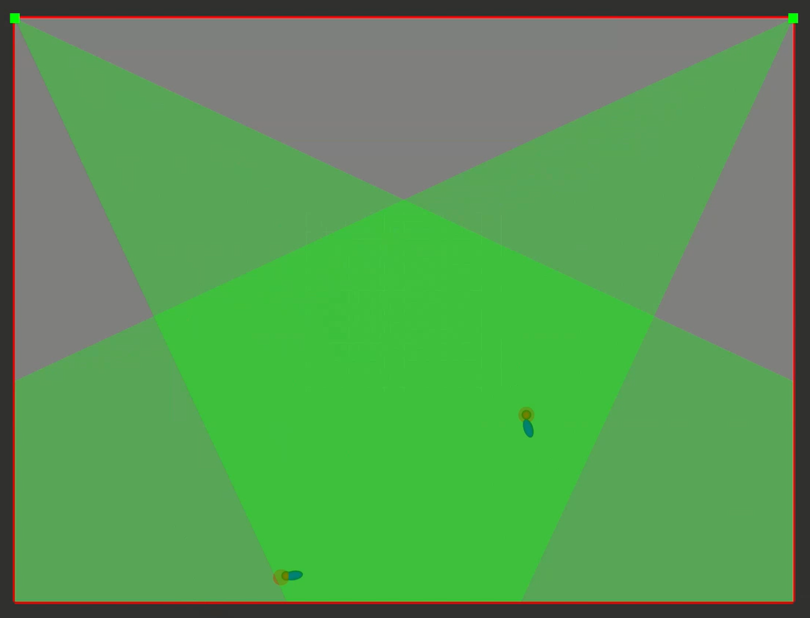
Results
LiDAR detection increases uncertainty because of high measurement noise and no measurement of orientation angle

Slide 21
Thank you for your attention

